Slide 1
Good-day
Estimados estudiantes, con el fin de mejorar la forma en que trabajan en el ramo de inglés, les recordaré de algunas herramientas que tienen a su disposición para ayudarse en nuestras clases a distancia.
Primero, recuerden que casi todos los videos que incluyo en mis clases están alojados en YouTube. Esto significa que pueden: obtener subtítulos en el idioma que estimen conveniente y pueden disminuir la velocidad de reproducción del video.
Segundo, en los videos alojados en YouTube, en algunos casos pueden obtener la transcripción del video completo (obtener el diálogo escrito de lo que hay en el video) como en el video que tendrán que observar en esta lección. (mas adelante explico cómo obtenerlo)
Pueden ayudarse de traductores online (google es bueno si es que traducen oraciones completas, nunca una palabra sola) y diccionarios urbanos (urbandictionary.com).
Finalmente, la mejor herramienta para aprender inglés es la práctica, por lo que les recomiendo se acostumbren a no utilizar traductor de inmediato cuando tengan que escribir para este ramo. Primero, intente escribir con el inglés que sepa, y luego, puede ayudarse de traductores y diccionarios para complementar y mejorar lo que ya había realizado.
Espero disfruten de esta clase, y no sientan estrés por tener que entregar actividades, pues recuerden que en inglés la forma de evaluación sigue pendiente. Realicen esta clase como un acto de amor propio, para su cerebro y su bien estar emocional. Espero que se encuentren bien, y quiero que sepan que hacemos lo posible por evitar ser una carga más en un momento tan difícil. Saludos.
Teacher Nicolas Puga Arriagada

Slide 2
Lesson 2 - Human Rights

Slide 3
Lesson 2: Building a critical view on human rights
Objective: to make connections related to the different views on human rights among different cultures
Activities:
Remember vocabulary from previous class
Watch a video about human rights
Compare information between different sources
Report your findings

Slide 4
1. Do you Remember these words?
Restraint, Freedom, Fair, Obey, bias in favor of
Complete the sentences using keywords from our previous class. Check your answers in the next slide. Write this activity on your copybooks.
This new law is clearly of the rich
You don’t have the right to me from studying
Before you sentence me, I have the right to a trial
I have a universal right that protects my to move anywhere
The State is forced to the law

Slide 5
1. Do you Remember these words? - Check your answers
Restraint, Freedom, Fair, Obey, bias in favor of
Check your answers, write the correct version in your copybooks.
This new law is clearly bias in favor of the rich
You don’t have the right to restraint me from studying
Before you sentence me, I have the right to a fair trial
I have a universal right that protects my freedom to move anywhere
The State is forced to obey the law

Slide 6
2. How necessary are human rights in a globalized world?

Slide 7
2. Human rights in a globalized world.
Human Rights have a lot of sense when there is war, hunger(famine), conflict, or wold-scale epidemics such as Coronavirus.
However, we can forget that Human Rights are violated every single day in many places, even when there is no war or conflict.
For example, poverty has led thousands of people to make their children work in farms. This is known as Child-labor and it is condemned by the UN and many countries.
In the US, for example, tobacco farms are known to have child labor in inhuman conditions. No access to restrooms, fresh water, or health.
You will watch a video that illustrates this violation to human rights in one of the most rich and powerful countries in the world. We tend to think that extreme poor countries may violate human rights more often, and this video helps you to understand that this is not always the case.
https://youtu.be/0-8TBceaO5Q

Slide 8
2. Human rights in a globalized world.
Watch the video again https://youtu.be/0-8TBceaO5Q, and find the answer to these questions:
1. In the morning, these children board a school bus, but they aren’t going to their schools, where are they going?
2. What are some health effects of working in tobacco farms?
3. These children are exhausted because they work for many hours a week. How many hours a week do they work?
4. At the end, these children say what they expect from their own children in the future. What is it?
Para completar esta parte, te recomiendo ver la transcripción del video disponible en YouTube. En la próxima diapositiva te explico cómo visualizar esta herramienta.

Slide 9
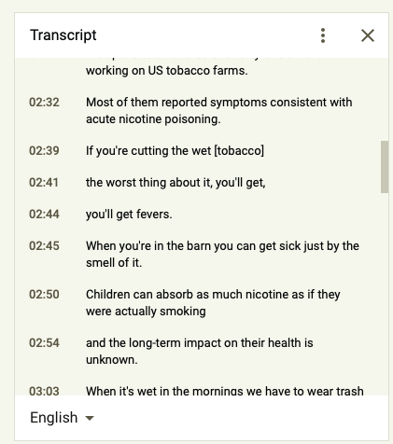
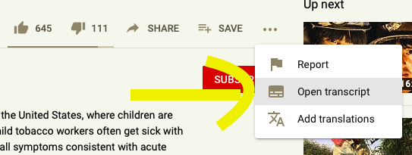
¿Cómo visualizar una transcripción en YouTube?
Primero, haz clic en los tres puntos. Después, haz clic en abrir transcripción (open transcript) y se abrirá una ventana con la transcripción del video completo.

Slide 10
2. Human rights in a globalized world. Check your answers
Now check your answers, write the correct answers in your copybooks.
1. In the morning, these children board a school bus, but they aren’t going to their schools, where are they going?
> they are going to the tobacco farm. This is where they work.
2. What are some health effects of working in tobacco farms?
> you can suffer nicotine poisoning, intoxication by pesticides, cancer, and vomits.
3. These children are exhausted because they work for many hours a week. How many hours a week do they work?
> They work around 50 to 60 hours a week
4. At the end, these children say what they expect from their own children in the future. What is it?
> they said they would not want their own kids to work in a farm, because they know how hard it is.

Slide 11
3. Comparing cases
Watch the video and find similarities

Slide 12
3. Compare Tobacco farms to other cases
Tobacco farms in the US are just one example of how accepted it is to have children working under inhuman conditions.
Watch this video (https://youtu.be/ckz4qccSVpY), and try to find similarities between Tobacco farms and the cases presented in this video.
What are the similarities between children in tobacco farms and children in other parts of the world?
Find at least 3 similarities:
1. .
2. .
3. .

Slide 13
3. Compare - Check your answers
Check your possible answers. There might be more!
What are the similarities between children in tobacco farms and children in other parts of the world?
Find at least 3 similarities:
1. Children work because they are poor .
2. They work putting their health at risk .
3. Laws are not strong to protect these children.
Escribe tus ideas en tu cuaderno. Si alguna de las que yo escribí no las tenías, agrégalas a tu lista de similitudes entre los dos videos.

Slide 14
4. Writing your opinion about child labor
Final practice activity

Slide 15
4. Final practice
In a short opinion essay, explain your point of view in relation to the videos we watched.
I will give you a structure of a paragraph you can follow, make sure you complete this with your own ideas.
1. Title of the essay: Piensa en un título que muestre parte de tu opinión.
2. Overview of your opinion: Resume tu punto de vista en una oración. Estás a favor o en contra de una idea? aquí tienes que dejar en claro eso.
3. Reason 1: la primera razón para justificar tus ideas debe ser la más obvia o coherente. Pero no la más importante.
4. Reason 2: Aquí también tienes que justificar tu opinión. Puedes incluso, incluir ideas de otros autores.
5. Reason 3: Esta es la justificación más importante. La que le da peso a tu opinión.
6. Conclusion: Aquí solo debes resumir las tres razones que justifican tu opinión en una oración más simple.
Observa la siguiente diapositiva para que veas un ejemplo de lo que debes hacer

Slide 16
4. Final practice
In a short opinion essay, explain your point of view in relation to the videos we watched. Are you against child labor? Why? Are you in support of children working to survive? Why?
1. Title of the essay: Work is for adults, period.
2. Overview of your opinion: child labor is a sign of abuse and is not ok.
3. Reason 1: Human Rights declaration protects children from working, they should not work.
4. Reason 2: many children work under inhuman conditions, they can get sick.
5. Reason 3: A child should have only two concerns: to study and to enjoy.
6. Conclusion: child labor is an abusive practice condemned by the UN. Many children suffer health problems and do not go to school because they have to work.

Slide 17
The end - Self evaluation checklist
Categories | ✓ or X
I read all titles, explanations and examples. (Leí todos los títulos, explicaciones y ejemplos)
2. I wrote all the explanations and exercises on my copybook. (escribí todas las explicaciones y ejercicios en mi cuaderno)
3. I watched and visited all videos and links. (Vi y visité todos los videos y links de la guía)
4. I completed all the exercises (completé todos los ejercicios de la guía)
5. If I had doubts, I asked my teacher to help me. (Si tuve dudas, le pedí ayuda a mi profesor )
6. I sent my work to the teacher (le envié mis trabajo al profesor)

